Slide 1

Requirement Review
Author: Adib Farrasy
Date: 08/08/2020
Where we are
SHALL
MUST
SHOULD
0%
0%
0%
completion
completion
completion
Q3 2020 Target: 100%
Q3 2020 Target: 50%
Q3 2020 Target: 0%

Slide 2
Requirement Review
Agenda #1
Requirement Name: Product should be minimalistic
Agenda #2
Requirement Name: Product should be aesthetically pleasing
Agenda #3
Requirement Name: Product should clearly show Mera brand

Slide 3
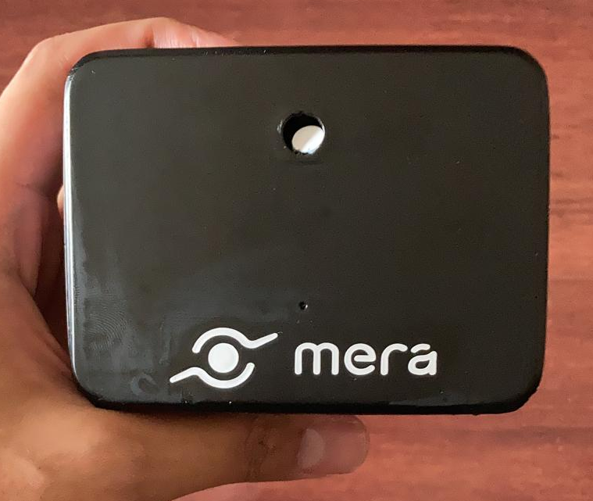
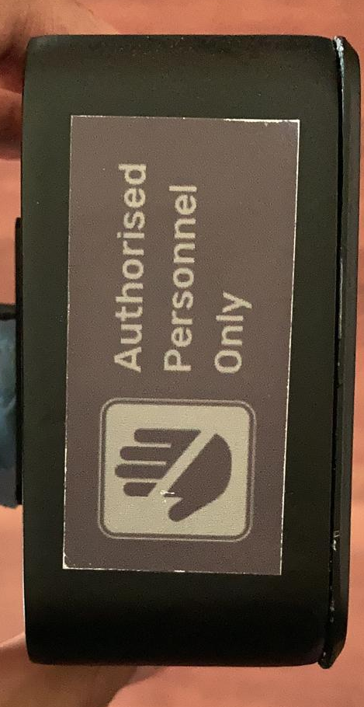
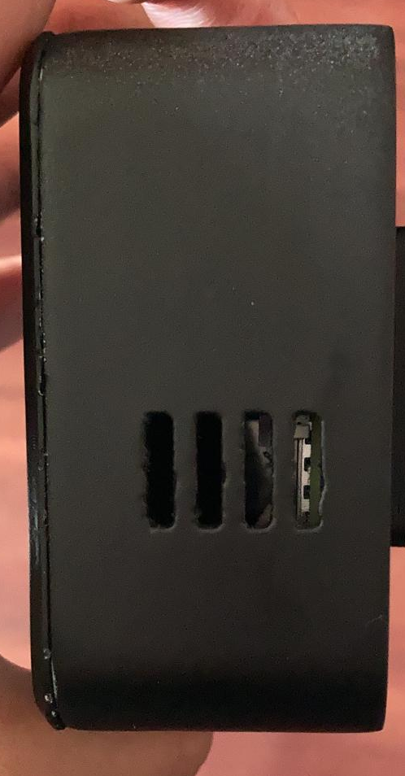
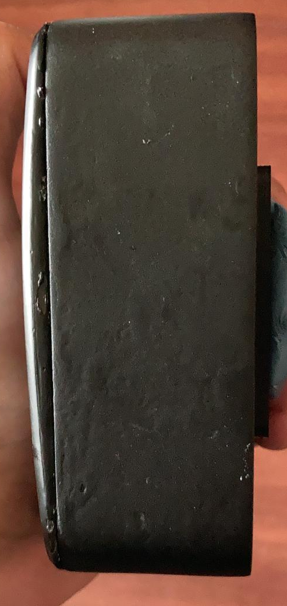
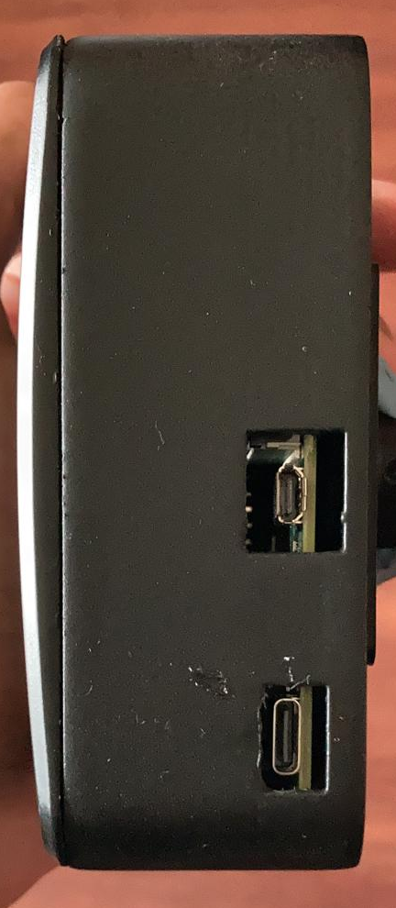
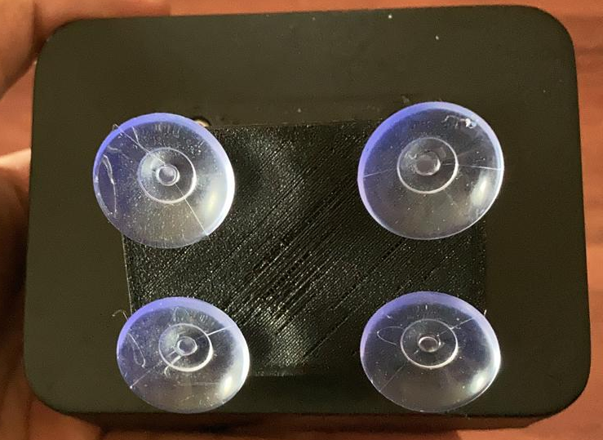
Peer Review
Agenda #1
Product should be minimalistic.
Primary view/ Facade:
Secondary views:
Tertiary views:
sticker
mounts
vent holes
Cable holes
camera
Indicator light
Back
logo
Right
Left
Bottom
Top
Result | PASS/ ALLOW / FAIL
Test Resolution | Full Product
Core Team Signoff | <Hilmy/ Agil/ Fatchur>
NEED SIGNOFF
Quality OK?
Features OK?
Minimalism achieved?
Notes:
Agil: all OK, need validation of suction cup strength
Hilmy: all OK, change sticker color
Fatchur: all OK

Slide 4
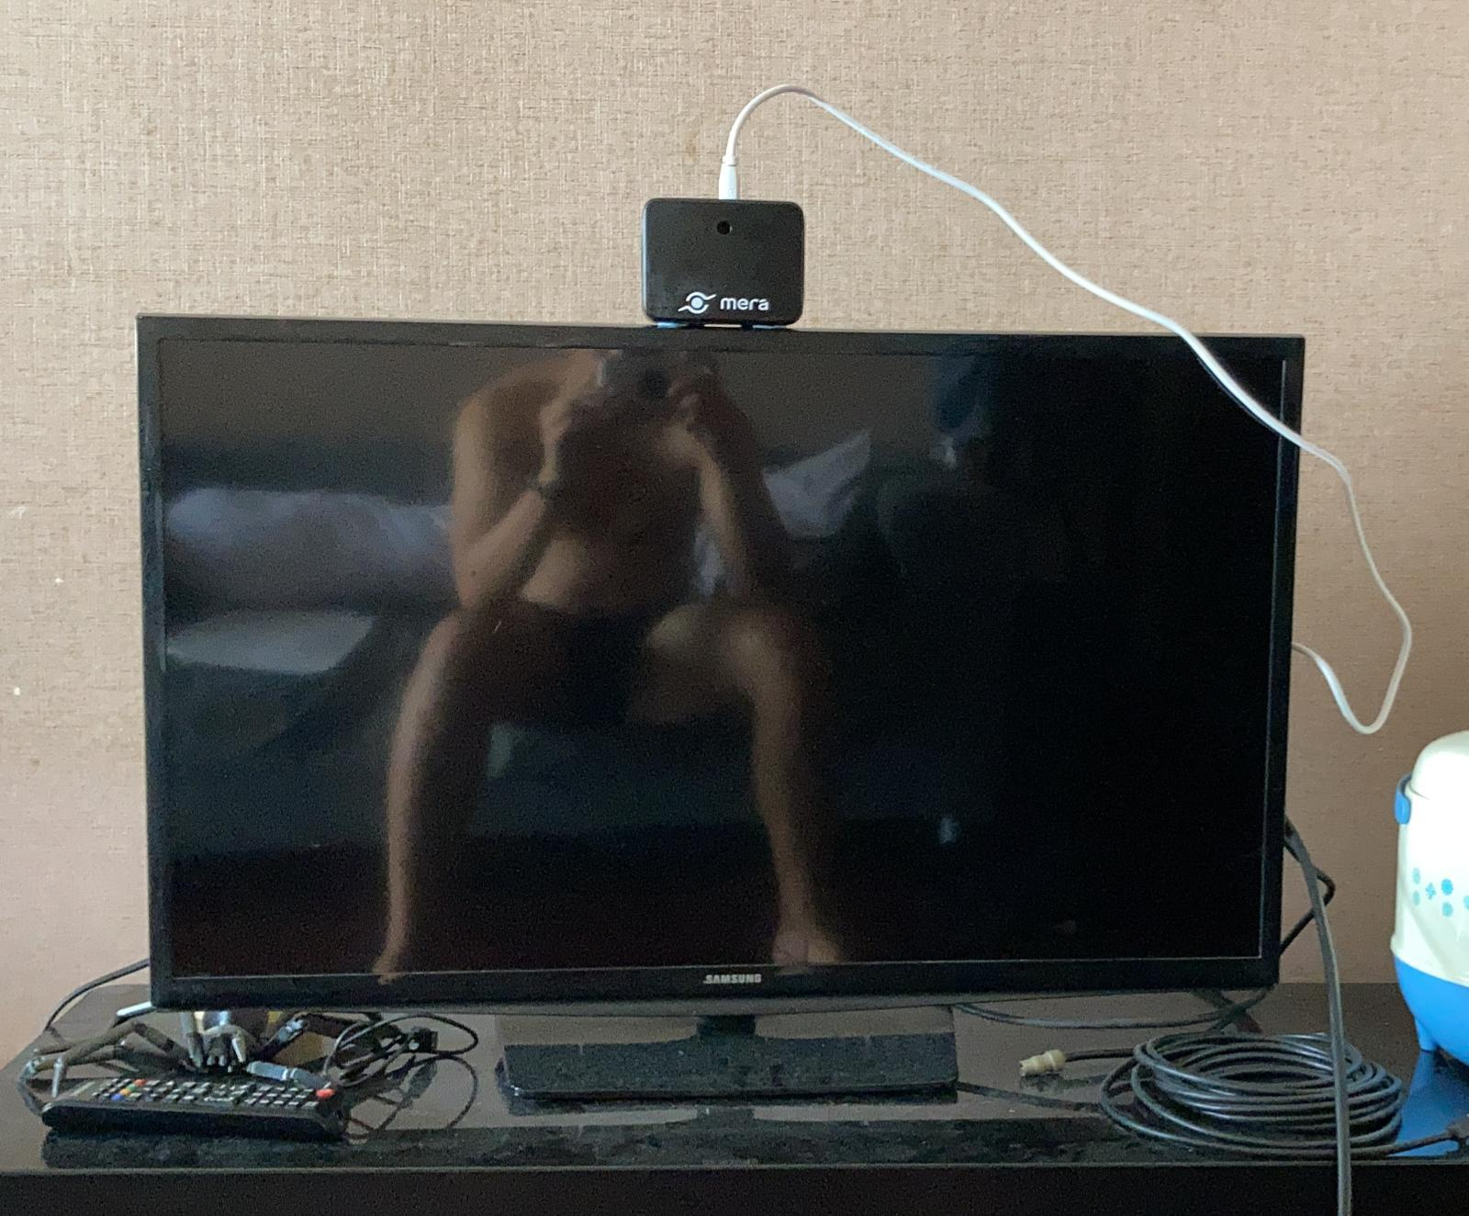
Peer Review
Agenda #2
Product should be aesthetically pleasing.
Primary view/ Facade:
Device footprint:
100mm x 75mm
40mm thk without mounts, ~88mm thk with mounts.
4.9”
32”
Result | PASS/ ALLOW / FAIL
Test Resolution | Full Product
Core Team Signoff | <Hilmy/ Agil/ Fatchur>
NEED SIGNOFF
Device size OK?
Device position OK?
Visible wires OK?
Notes:
Hilmy: size OK, position ALLOW: prefer higher position, visible wires NOT OK
Agil: size OK, position OK, visible wires NOT OK
Fatchur: size OK, positon OK, visible wires NOT OK
TRY L-shaped cable facing back, black color

Slide 5
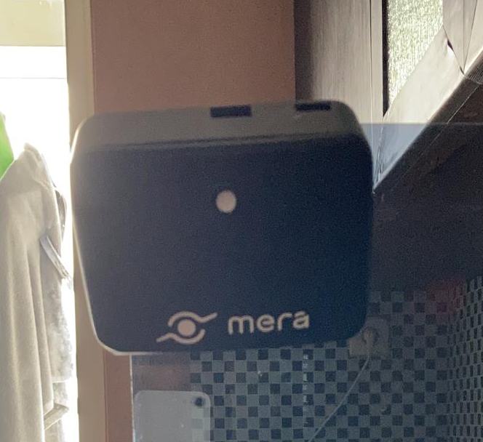
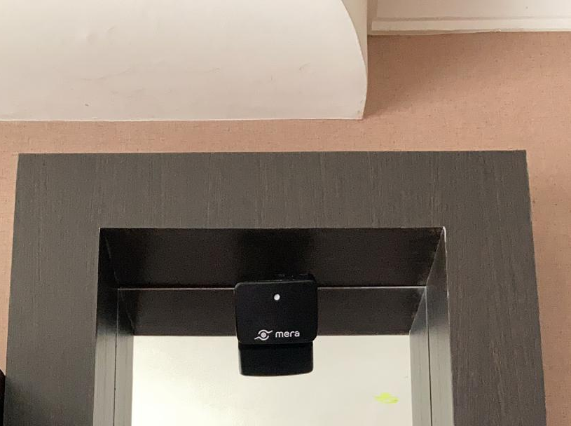
Peer Review
Agenda #3
Product should clearly show Mera brand.
Unresized photos:
Taken at eye level, angle adjusted to show device
Device @ eye level
Device @ ~2.5m height
Result | PASS/ ALLOW / FAIL
Test Resolution | Full Product
Core Team Signoff | <Hilmy/ Agil/ Fatchur>
NEED SIGNOFF
Logo visibility OK?
Brand name visibility OK?
Notes:
Hilmy: visibility OK, name OK
Agil: visibility OK, name OK
Fatchur: visibility OK, name OK

Slide 6
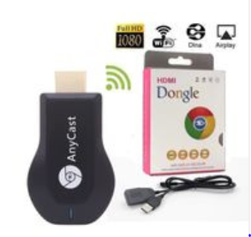
Alternative Approach
RISK: Current design may not be aesthetically pleasing.
Addressing wires: use Bluetooth HDMI.
Addressing size: use Pi Zero W (DESIGN OVERHAUL)
Addressing position:
mount to the side nearest to the HDMI port (if using cable)
mount further up to be more discreet?
Notes:
Bluetooth HDMI: Compatibility issue? Reliability issue?

Slide 7
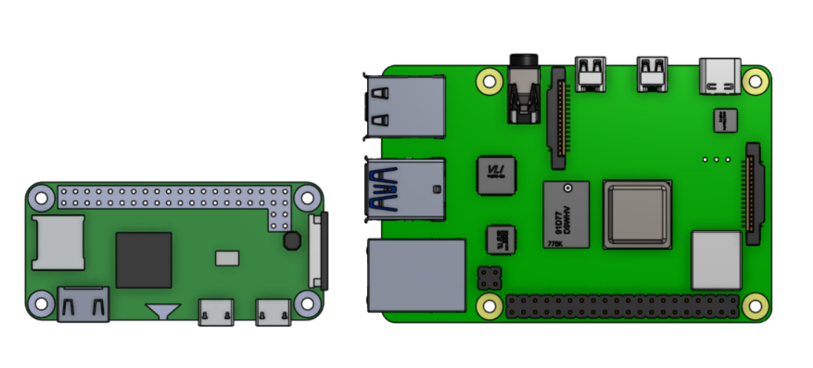
Alternative Approach
 | Pi Zero W | Pi 4B 2GB
Dimension | 66.0mm x 30.5mm x 5.0mm | 85.6mm × 56.5mm x 18.6mm
Processor | 1.0GHz, single core | 1.5GHz, quad core
RAM | 1GB | 2GB
Cost | US$10 (Rp172.000)/ Rp370.000 Tokopedia | US$35 (Rp520.000)/ Rp 710.000 Tokopedia

Slide 8
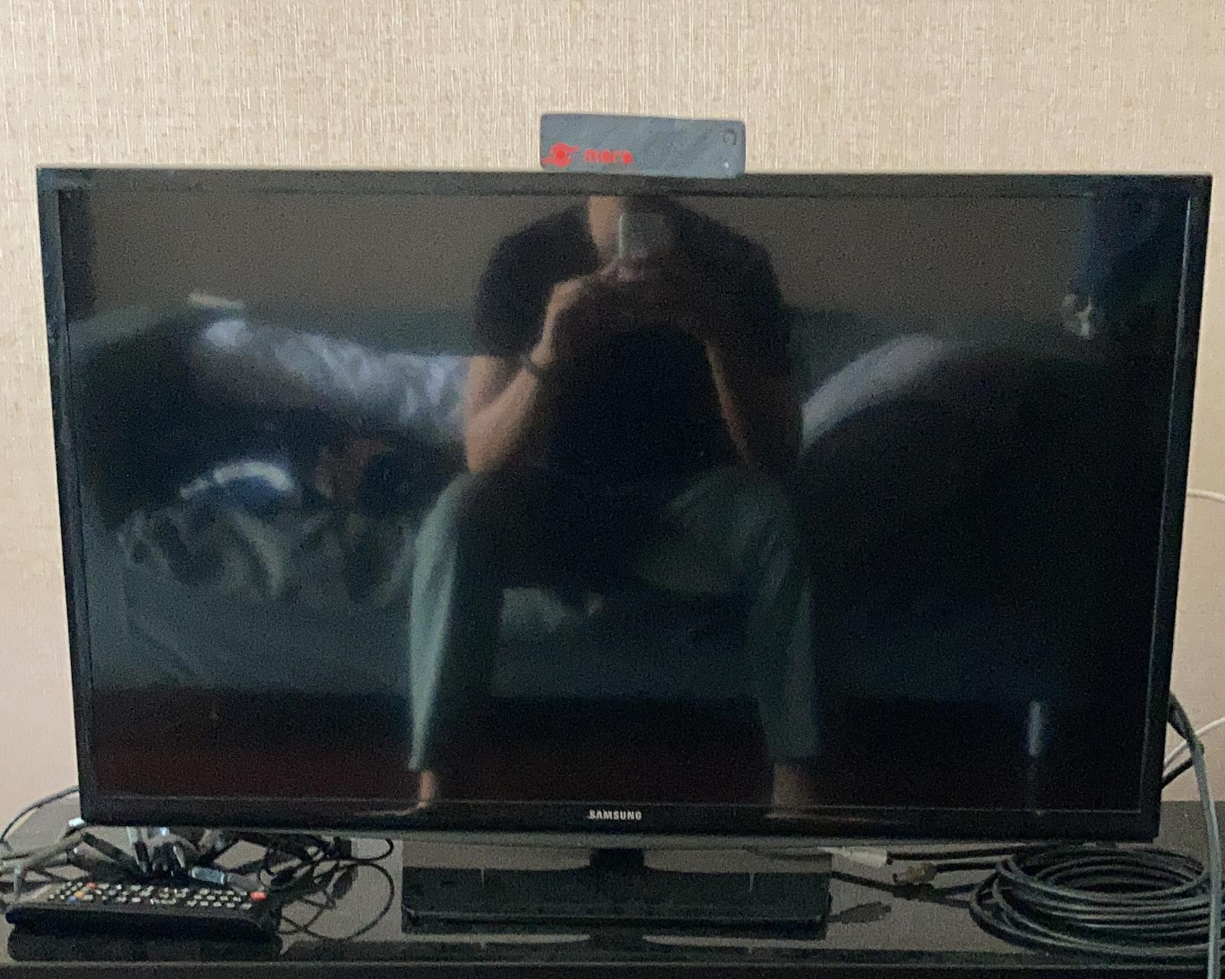
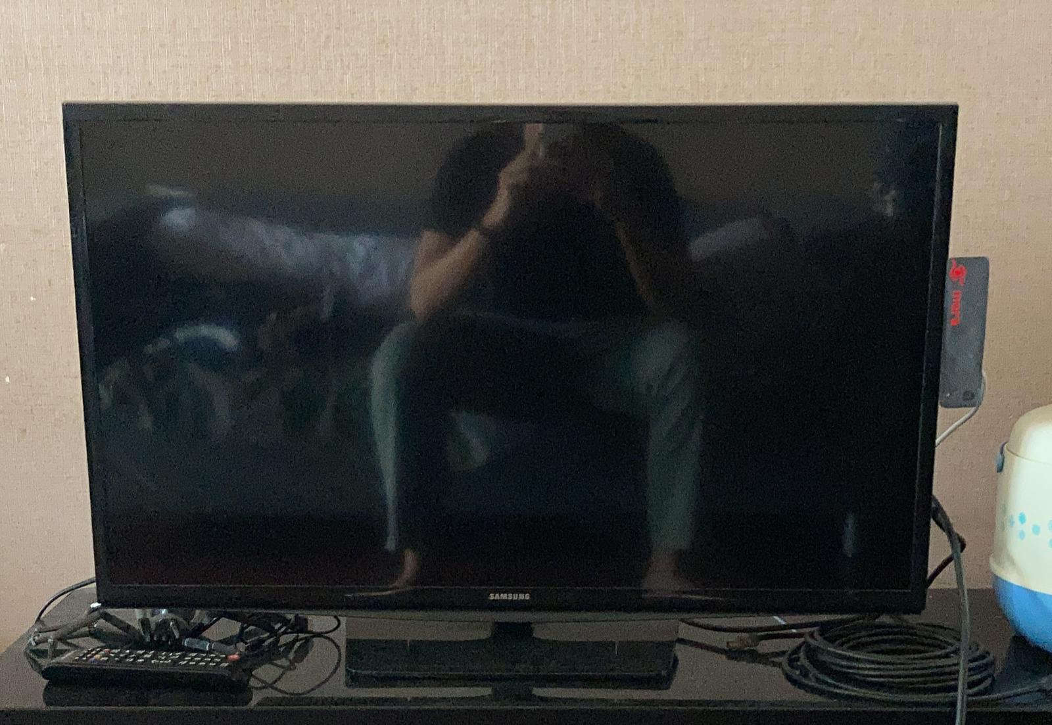
Mera Lift Pi Zero Preview
Primary view/ Facade:
Device footprint:
130*mm x 35mm
40mm thk without mounts, ~88mm thk with mounts.
*length can be shortened up to 80mm
5.3”
Orientation Option A
Top of TV
MUST use BT-HDMI
Orientation Option B
Side of TV (nearest to HDMI port)
Don’t need BT-HDMI

